Slide 1
Advanced Systems Analysis and Design User Interface Design SOFT 30121 L13

Slide 2
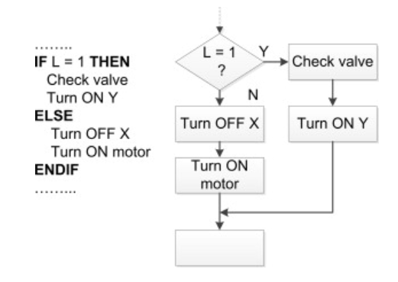
Program design
RecoSystems Analysis and Design
Alan Dennis; Barbara Haley Wixom; Roberta M. Roth
2019
Chapter 10

Slide 3
Program Design
After this lecture, you should be able to:
Describe the purpose and components of a structure chart.
Explain the two primary structures shown in a structure chart and the purpose of each.
Explain the structure chart design guideline of high cohesion
Explain the structure chart design guideline of low coupling. List and discuss the five kinds of coupling.
Explain how the concepts of fan‐in and fan‐out pertain to structure charts.
Explain the recommended content of a program specification document.
Describe pseudocode and explain how it differs from structured English.

Slide 4
Introduction
Program design is the part of the design phase of the SDLC during which analysts determine what programs will be written, create instructions for the programmers about what the code should do, and identify how the pieces of code will fit together to form the system.
Some people may think that program design is becoming less important. Project teams increasingly rely on packaged software or libraries of preprogrammed code to build systems. Program design techniques are still very important, however, for two reasons. First, even the preexisting code needs to be understood, organized, and pieced together. Second, it is still common for the project team to have to write some (if not all) code and produce original programs that support the application logic of the system.

Slide 5
Introduction
Moving from analysis to design on our business flows.
When we were working with our stakeholder it was important that we use tasks and events that they recognise.
Now we are taking those tasks from our business flow and these are becoming the modules that we are designing.
At at analysis level you might have a process that touches a data store.
At design level you have a module that Creates, Retrives, Updates, or Deletes data from your entities.

Slide 6
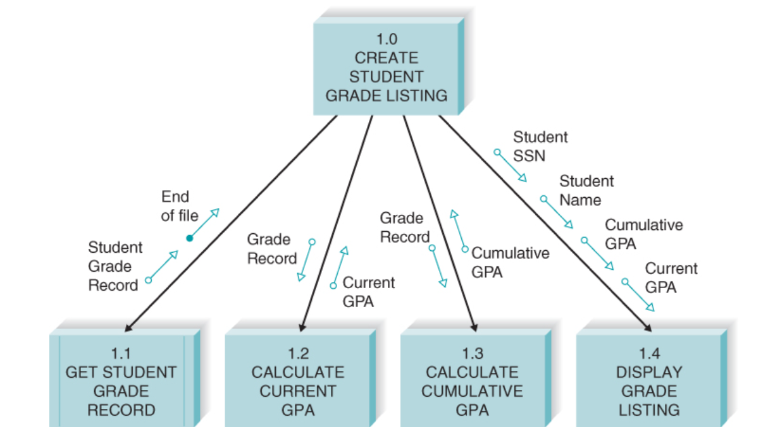
Creating your Module Structure

Slide 7
Nigel’s viewpoint of this example
This example looks like the internal structure of a module.
I would be unlikely to delegate different parts of this to different engineers. They would each have to understand each others code to make any progress. That might be good for organizational resilience, but not very efficient. I would expect the structure of somebody’s code to look a lot like this. Methods within a student grade class.

Slide 8
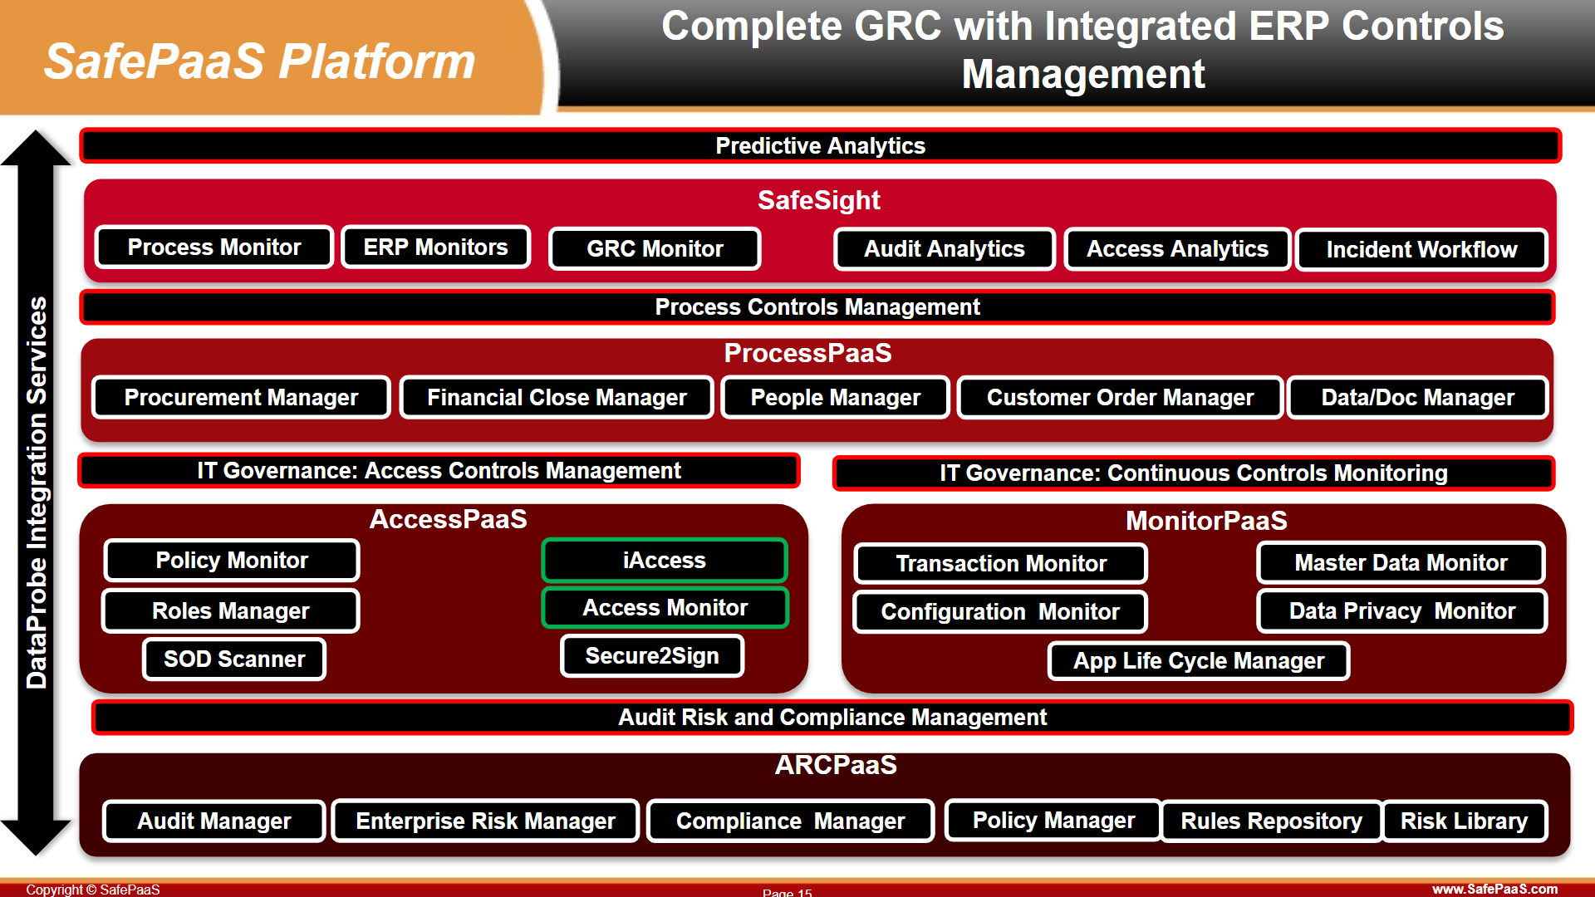
You have to think through this level first

Slide 9
Nigel’s Viewpoint
SafePaaS is not a particularly large system, but the architecture needs to be thought through at this larger scale by an analyst.
For example, Process monitor has many modules within it.

Slide 10
Building a Structure Chart
You will definitely need to understand the structure of your application.
There was much in the book on this topic that seemed overly academic. At the end of the day you have to group functionality so that the development can be organized and so the user can find the functionality
There was one concept that I recognize. The book points out that the program design starts with processes. This seems true. It breaks them down into
Transactional Flows. Components of which tend to be in menus.
Transformative Flows. Components of which tend not to be in menus.

Slide 11
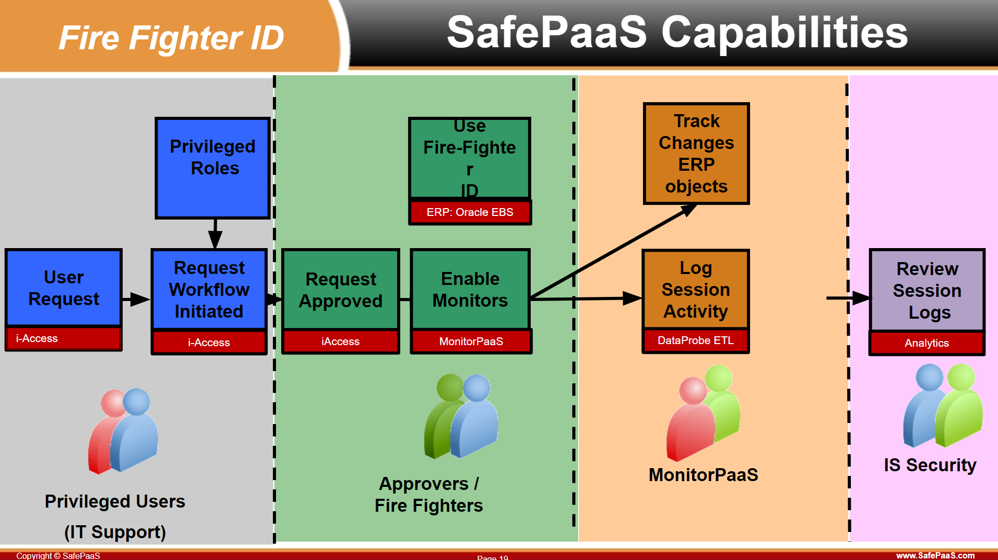

Slide 12
Building a Structure Chart
You will definitely need to understand the structure of your application.
There was much in the book on this topic that seemed overly academic. At the end of the day you have to group functionality so that the development can be organized and so the user can find it.
There was one concept that I recognize. The book points out that the program design starts with processes. This seems true. It breaks them down into
Transactional Flows. Components of which tend to be in menus.
Transformative Flows. Components of which tend not to be in menus.

Slide 13
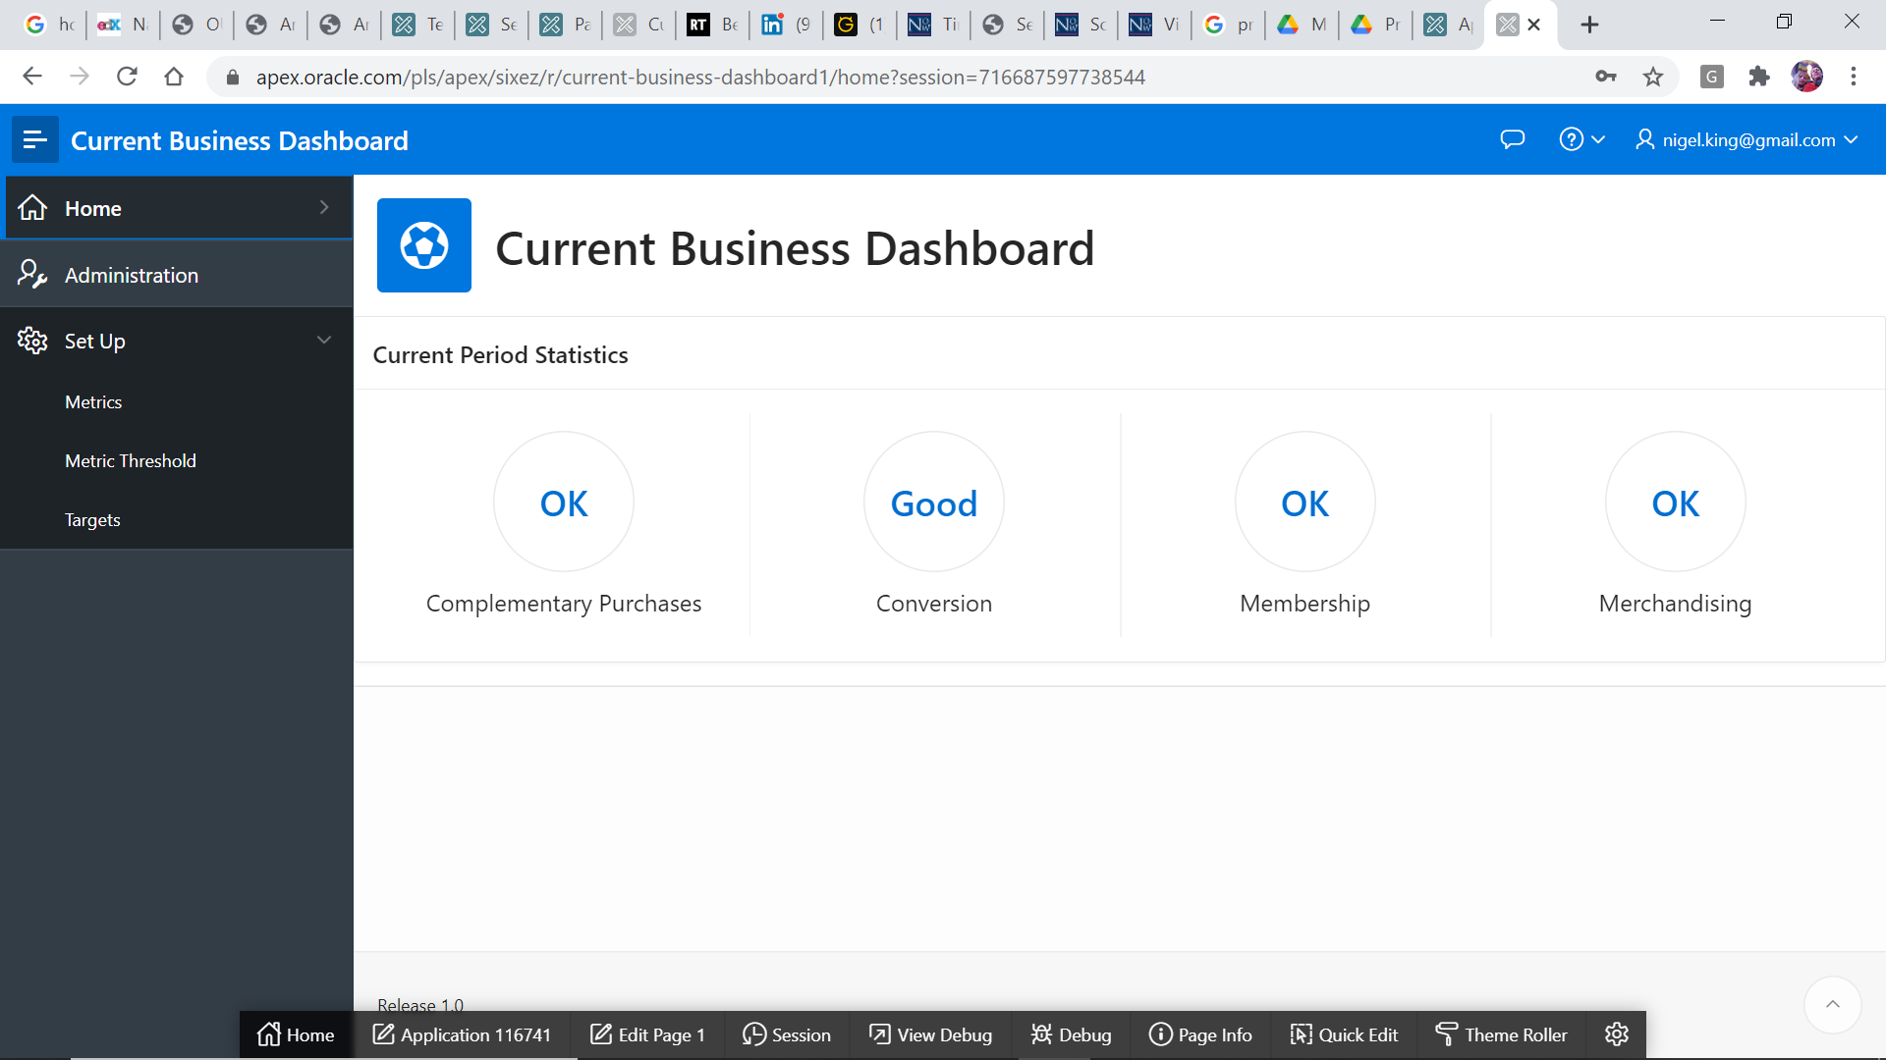
Transactional Flows
Setting up metrics and targets

Slide 14
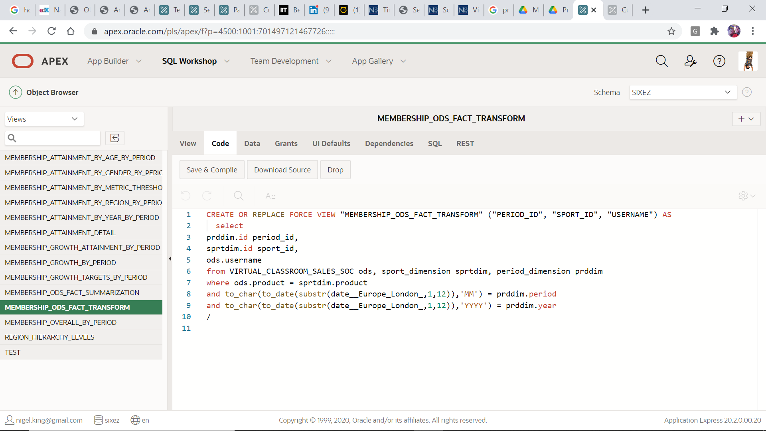
Transformative Flows
Transforming from Data Lake to ODS and Summarizing

Slide 15
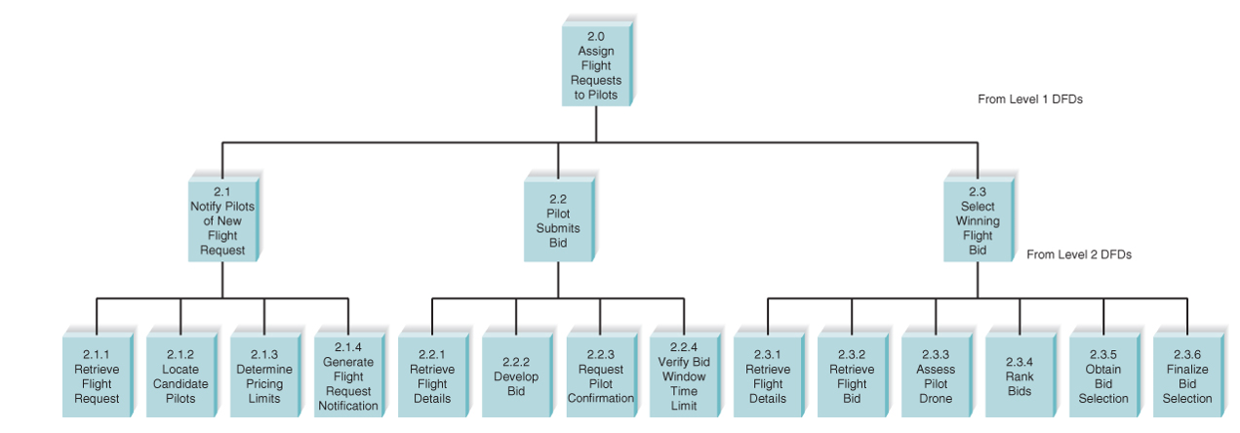
Levels in your processes diagram should become levels in a functional decomposition.

Slide 16
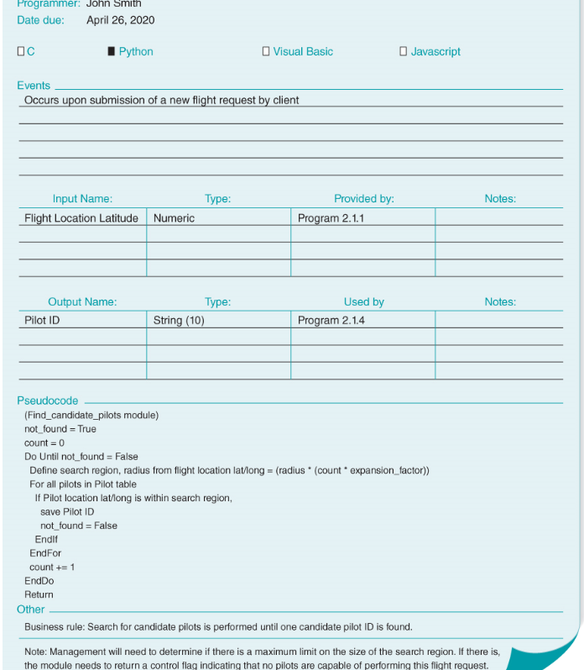
Specification Documentation
Components
Program Information
Events
Inputs and Outputs
Pseudocode
Pseudocode is a language that contains logical structures, including sequential statements, conditional statements, and iteration. It differs from structured English in that pseudocode contains details that are programming specific, such as initialization instructions or linking, and it also is more extensive so that a programmer can write the module by mirroring the pseudocode instructions.

Slide 17
Nigel’s Viewpoint
My read of the fashion is less on program specification and more on test specification. Test based development or test first development seems widely accepted as a good practice, whereas even 30 years ago, my first manager at Oracle was adamant that the best documentation was well commented code.
The level of analysis to identify: requirements, a process flow, entities and a UI design seem unavoidable. Beyond that there is a cost / benefit conversation to be had.
The split between analyst and programmer is by no means clean and many programmers are doing the design at this level, especially as their careers progress.
It is not clear to me that non programmers find Pseudocode useful, and programmers will be grateful if your code is easy to follow.
Design documentation is rarely kept up to date as code progresses.

Slide 18
Program Design Principles
Build Modules With High Cohesion
Modules should do one thing well.
It should not do unrelated things
Unrelated functionality should be factored out to other modules
Build Loosely Coupled Modules
Build modules that do one thing well without too much outside help.
Chatty applications mean bringing more teams into design conversation.
Design dependencies mean installation dependencies
Create High Fan‐In (Promoted Reuse)
Promote re-use whenever practical.
One mans reuse is another mans coupling
Avoid High Fan‐Out (Don’t make modules too small)
It makes code harder to read and follow.

Slide 19
A Reasonable Module Code Review Checklist
✓ Library modules have been created whenever possible.
✓ Modules have been reused where appropriate.
✓ Control modules have no more than seven subordinates.
✓ Each module performs only one function (high cohesion).
✓ Modules sparingly share information (loose coupling).
✓ Data couples that are passed are actually used by the accepting module.
✓ Each module has a reasonable amount of code associated with it.

Slide 20
International Standards on Code Quality
ISO 9126 was the international standard for software quality.
ISO 25010 is its successor, but 9126 still has more traction. We will be asking you to review your code according to 9126 as part of the assessment.

Slide 21
ISO 9126
The ISO 9126-1 software quality model identifies 6 main quality characteristics, namely:
Functionality
Reliability
Usability
Efficiency
Maintainability
Portability

Slide 22
Functionality
Subcharacteristics | Definitions
Suitability | This is the essential Functionality characteristic and refers to the appropriateness (to specification) of the functions of the software.
Accurateness | This refers to the correctness of the functions, an ATM may provide a cash dispensing function but is the amount correct?
Interoperability | A given software component or system does not typically function in isolation. This subcharacteristic concerns the ability of a software component to interact with other components or systems.
Compliance | Where appropriate certain industry (or government) laws and guidelines need to be complied with, i.e. SOX. This subcharacteristic addresses the compliant capability of software.
Security | This subcharacteristic relates to unauthorized access to the software functions

Slide 23
Reliability
Subcharacteristics | Definitions
Maturity | This subcharacteristic concerns frequency of failure of the software.
Fault tolerance | The ability of software to withstand (and recover) from component, or environmental, failure.
Recoverability | Ability to bring back a failed system to full operation, including data and network connections.

Slide 24
Usability
Subcharacteristics | Definitions
Understandability | Determines the ease of which the systems functions can be understood, relates to user mental models in Human Computer Interaction methods.
Learnability | Learning effort for different users, i.e. novice, expert, casual etc.
Operability | Ability of the software to be easily operated by a given user in a given environment.

Slide 25
Maintainability
Subcharacteristics | Definitions
Analyzability | Characterizes the ability to identify the root cause of a failure within the software.
Changeability | Characterizes the amount of effort to change a system.
Stability | Characterizes the sensitivity to change of a given system that is the negative impact that may be caused by system changes.
Testability | Characterizes the effort needed to verify (test) a system change.

Slide 26
Portability
Subcharacteristics | Definitions
Adaptability | Characterizes the ability of the system to change to new specifications or operating environments.
Installability | Characterizes the effort required to install the software.
Conformance | Similar to compliance for functionality, but this characteristic relates to portability. One example would be Open SQL conformance which relates to portability of database used.
Replaceability | Characterizes the plug and play aspect of software components, that is how easy is it to exchange a given software component within a specified environment.

Slide 27
Next Lecture
Data Storage Design

